Slide 1

CHAPTER 6
SET THEORY
Copyright © Cengage Learning. All rights reserved.

Slide 2

6.4
Boolean Algebras, Russell’s Paradox,
and the Halting Problem
Copyright © Cengage Learning. All rights reserved.

Slide 3
Boolean Algebras, Russell’s Paradox, and the Halting Problem
Table summarizes the main features of the logical equivalences and the set properties. Notice how similar the entries in the two columns are.

Slide 4
Boolean Algebras, Russell’s Paradox, and the Halting Problem

Slide 5
Boolean Algebras, Russell’s Paradox, and the Halting Problem
continued
Table 6.4.1

Slide 6
Boolean Algebras, Russell’s Paradox, and the Halting Problem

Slide 7
Boolean Algebras, Russell’s Paradox, and the Halting Problem
In any Boolean algebra, the complement of each element is unique, the quantities 0 and 1 are unique.

Slide 8
Boolean Algebras, Russell’s Paradox, and the Halting Problem

Slide 9
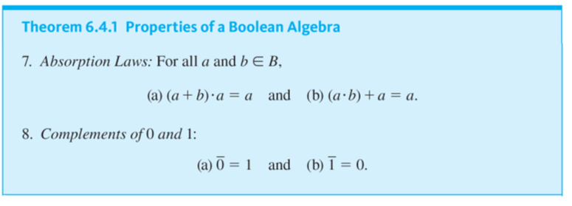
Boolean Algebras, Russell’s Paradox, and the Halting Problem
continued

Slide 10
Boolean Algebras, Russell’s Paradox, and the Halting Problem
Each of the paired statements can be obtained from the other by interchanging all the + and · signs and interchanging 1 and 0. Such interchanges transform any Boolean identity into its dual identity.
It can be proved that the dual of any Boolean identity is also an identity. This fact is often called the duality principle for a Boolean algebra.

Slide 11

Example 6.4.1 – Proof of the Double Complement Law
Prove that for all elements a in a Boolean algebra B,

Slide 12

Example 6.4.1 – Solution
Start by supposing that B is a Boolean algebra and a is any element of B. The basis for the proof is the uniqueness of the complement law: that each element in B has a unique complement, which satisfies certain equations with respect to it.
So if a can be shown to satisfy those equations with respect to
then a must be the complement of

Slide 13
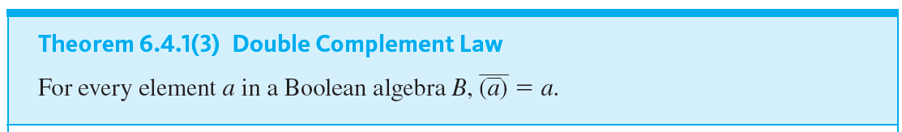
Boolean Algebras, Russell’s Paradox, and the Halting Problem

Slide 14
Example 6.4.2 – Proof of an Idempotent Law
Fill in the blanks in the following proof that for all elements a in a Boolean algebra B, a + a = a.

Slide 15
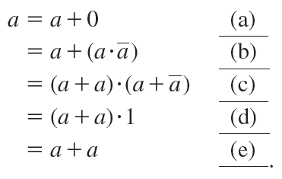
Example 6.4.2 – Proof
Suppose B is a Boolean algebra and a is any element of B. Then

Slide 16
Example 6.4.2 – Solution
(a) because 0 is an identity for +
(b) by the complement law for ·
(c) by the distributive law for + over ·
(d) by the complement law for +
(e) because 1 is an identity for ·

Slide 17
Russell’s Paradox

Slide 18

Russell’s Paradox
Russell’s Paradox: Most sets are not elements of themselves. For instance, the set of all integers is not an integer and the set of all horses is not a horse. However, we can imagine the possibility of a set’s being an element of itself. For instance, the set of all abstract ideas might be considered an abstract idea. If we are allowed to use any description of a property as the defining property of a set, we can let S be the set of all sets that are not elements of themselves:
Is S an element of itself?

Slide 19
Russell’s Paradox
The answer is both yes and no. For suppose S ∈ S. Then S satisfies the defining property for S, and hence S ∉ S. This contradicts the supposition that S ∈ S and shows that S ∉ S. Next suppose S ∉ S.
Then S is a set such that S ∉ S and so S satisfies the defining property for S, which implies that S ∈ S. This contradicts the supposition that S ∉ S and shows that S ∈ S.

Slide 20
Russell’s Paradox
Thus both S ∈ S and S ∉ S, which is impossible because a statement is either true or false but not both. To help explain his discovery to laypeople, Russell devised a puzzle, the barber puzzle, whose solution exhibits the same logic as his paradox.

Slide 21
Example 6.4.3 – The Barber Puzzle
In a certain town there is a male barber who shaves all those men, and only those men, who do not shave themselves. Question: Does the barber shave himself?

Slide 22
Example 6.4.3 – Solution
The answer is both yes and no. If the barber shaves himself, he is a member of the class of men who shave themselves. But no member of this class is shaved by the barber, and so the barber does not shave himself.
On the other hand, if the barber does not shave himself, he belongs to the class of men who do not shave themselves. But the barber shaves every man in this class, so the barber does shave himself.

Slide 23
The Halting Problem

Slide 24
The Halting Problem
Well before the actual construction of an electronic computer, Alan M. Turing (1912–1954) deduced a profound theorem about how such computers would have to work. The argument he used is similar to that in Russell’s paradox.
It is also related to those used by Gödel to prove his theorem and by Cantor to prove that it is impossible to write all the real numbers in an infinitely long list, even given an infinitely long period of time.

Slide 25
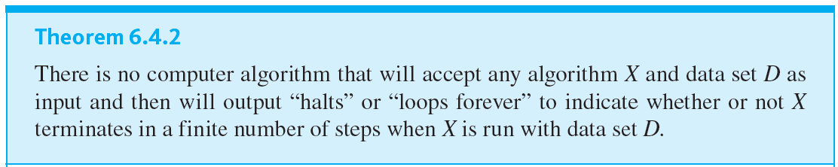
The Halting Problem

